Slide 1

Helping Hands
Selfless Service
Scrumdog Millionaires

Slide 2
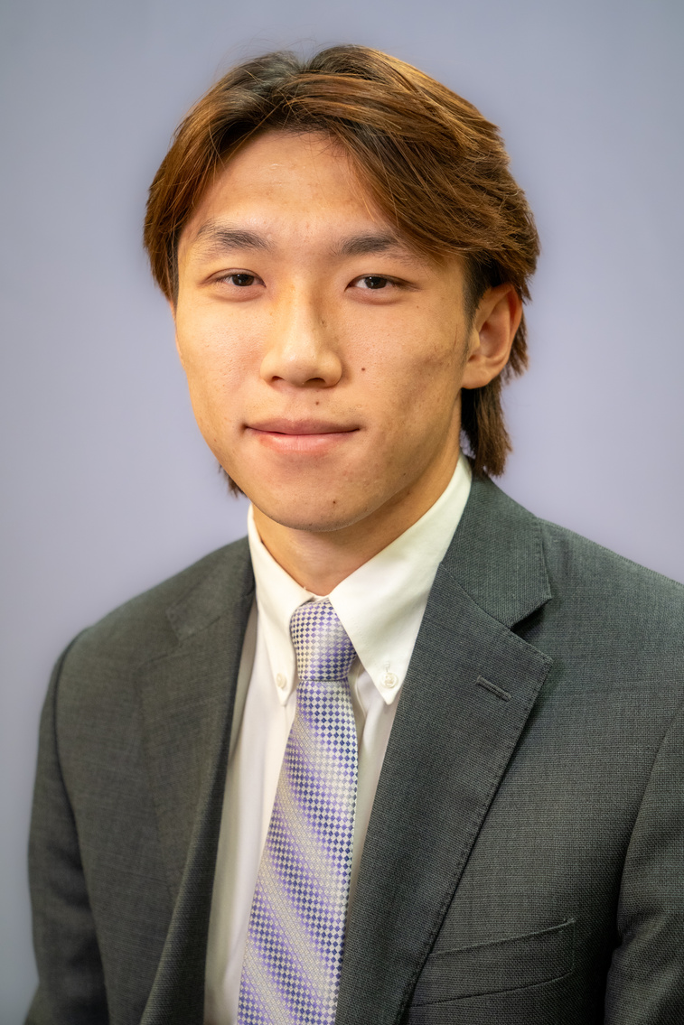

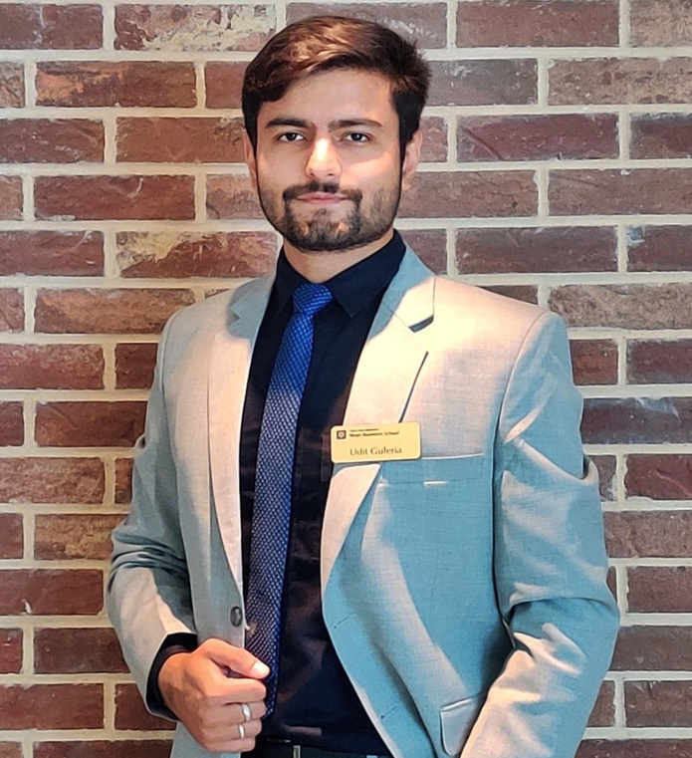

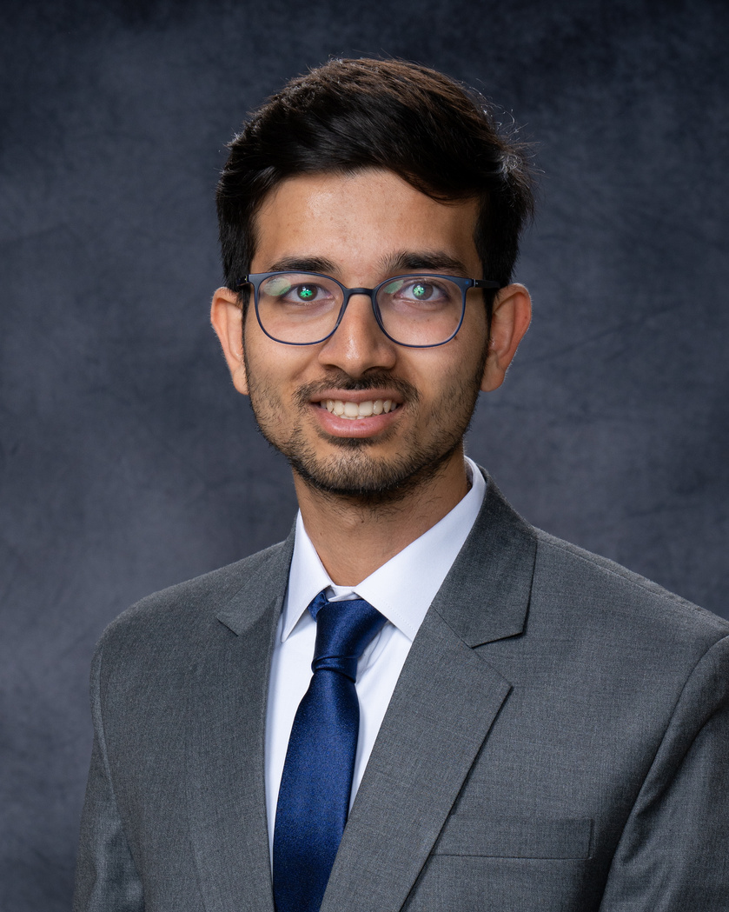
Team Members
Scrumdog Millionaires
Justin
Shefali
Udit
Vaibhav
Harsh

Slide 3
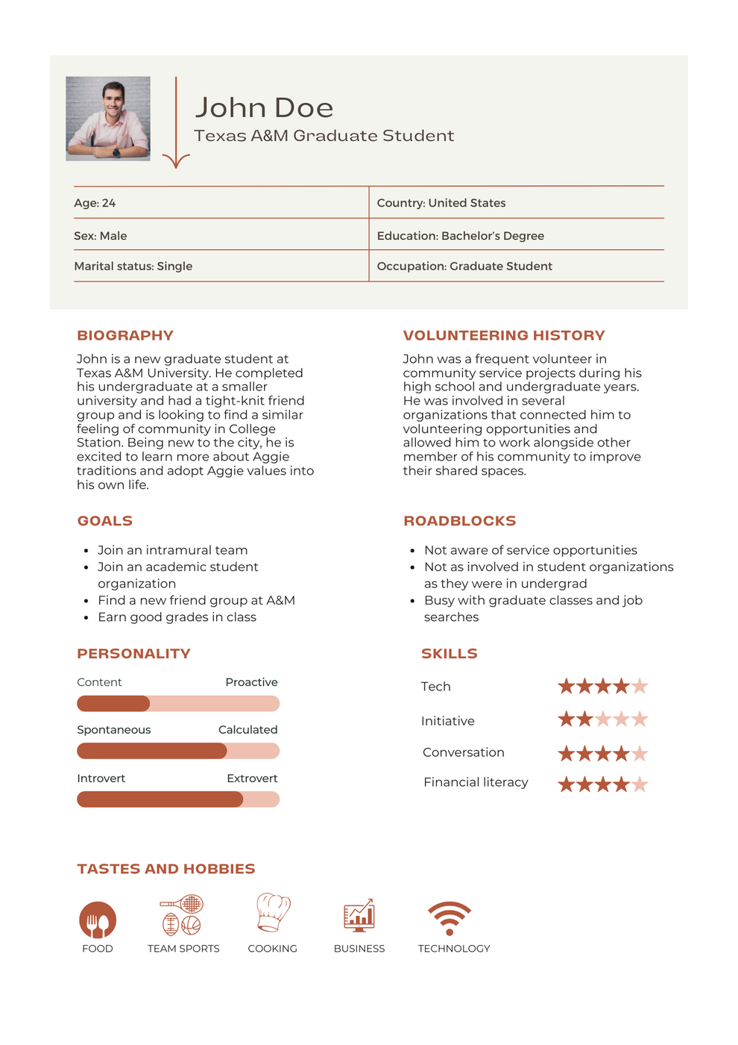
Problem Statement
“As an A&M community member, I want more discoverable local volunteering opportunities that align with my interests so I can give back to my community.”
“How Might We”
Statement
“How might we provide a way for A&M community members to easily discover volunteering opportunities that are aligned with their interests?”

Slide 4
Testing
5 participants
Laptop running Windows 11
Tasks based on core task flows and additional website features
All participants could complete all tasks

Slide 5
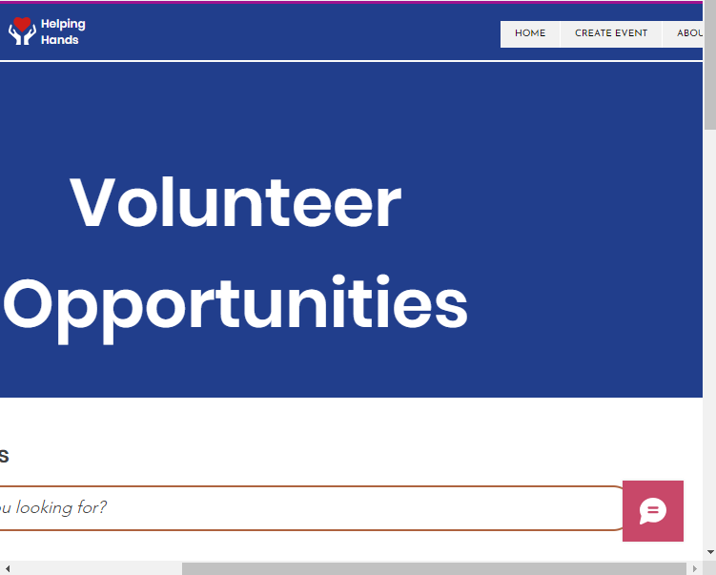
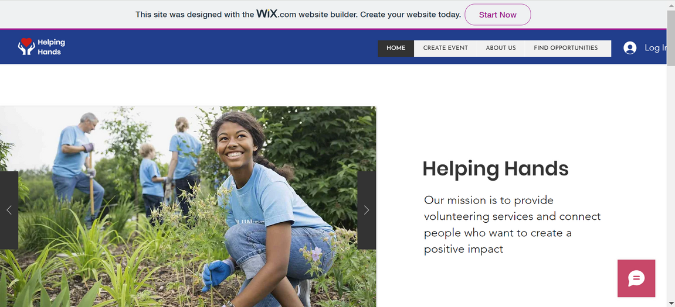
Relevant Findings
A few of the participants had problems with regards to page responsiveness.
Login button not being visible.
You can see that scrollbar is all the way to the right.

Slide 6
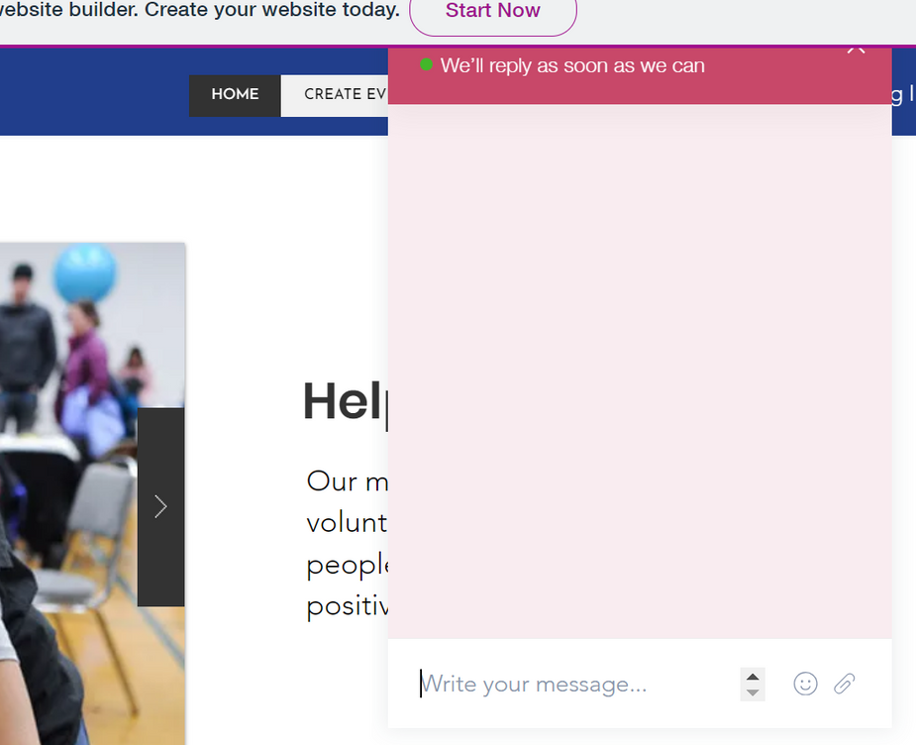
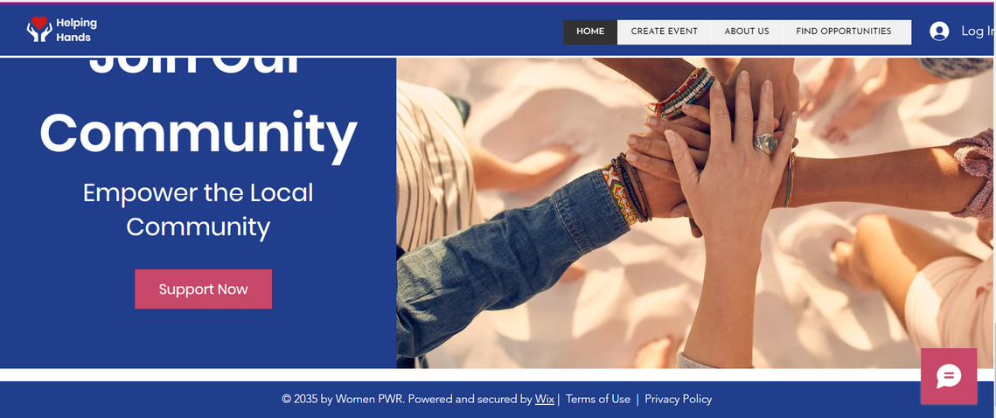
Relevant Findings
During task to search for contact information many participants first looked for the contact information at the bottom of the page
Lack of footer section with contact information

Slide 7
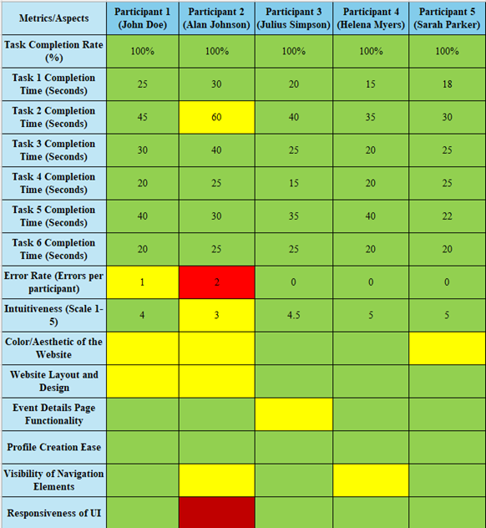
Stoplight Chart
Pull Quotes
Alan Johnson: "I cannot find the sign-up button to begin with."
Julius Simpson: "Contact details are hard to find... I usually go to the bottom of the page to find them."
Helena Myers: "I think the chatbot input area could be a little smaller."
Notes:
Alan Johnson: "I cannot find the sign-up button to begin with."
Explanation: Alan’s trouble in finding the sign-up button tells us there's a problem with how clear it is to new users to get started. This was due to incorrect dimensions of the homepage due to which the sign-up button was hidden. The website page dimensions need to be made adaptable and responsive in order to enhance the usability of the website.
Julius Simpson: "Hard to find... I usually go to the bottom of the page to find contact details."
Explanation: Julius didn't find the help where he expected it, which can make the site harder to use. It's important to put things where users naturally look for them.
This relates to user's mental models, which are the internal and simplified representations of how the users perceives a process works, and its based on their prior experiences. So we should design our website with user mental models in mind.
Helena Myers: "I think the chatbot area could be a little smaller."
Explanation: Helena’s comment suggests that while the chat feature is handy, its design needs tweaking not to overpower the page. Good usability

Slide 8
Stoplight Chart
Pull Quotes
Sarah Parker: "The pictures look great. It's pretty user-friendly."
John Doe: "I’m able to search for events without having to first create an account."
Sarah Parker: "If I was looking for volunteering opportunities in the future, I would definitely use this website."
Notes:
However, we also received positive feedback.
Sarah Parker: "The pictures look great. It's pretty user-friendly."
Explanation: Visceral Reaction. Positive feedback on visuals like pictures and the ease of using the site tells us that the website is enjoyable ,which is great for usability.
John Doe: "I’m able to search for events without having to first create an account."
Explanation: This feature John mentions is about accessibility, which is a big plus for usability. Letting users explore without signing up makes the website inviting and easy to get into.
Sarah Parker: "If I was looking for volunteering opportunities in the future, I would definitely use this website."
Explanation: Sarah's willingness to return to the website indicates it’s useful and meets her needs, which means the site is doing well in terms of usability. It's easy enough to navigate and find what she's looking for.

Slide 9
NEXT STEPS
1
2
3
Recommendation Engine
Role Based Features
Responsive
Pages
We want to integrate a personalized feed of events for users based on their interests on the homepage.
Organizations enrolled on our website should only be allowed to create an event.
Based on user feedback, we are working towards making the pages adjust and remain uniform across screen sizes.

Slide 10
Thank You
Let’s do a demo now
Helping Hands

